Slide 1

Department of ECE
Analog electronic Circuit Design
24ec2104
Topic:
Op-amp with negative feedback_2

Slide 2



AIM OF THE SESSION
This session aims to discuss the significance of voltage shunt feedback amplifier and differential amplifier.
INSTRUCTIONAL OBJECTIVES
This Session is designed to:
  Illustrate the working of inverting amplifier and differential amplifier with feedback.
  Compare the behavior of inverting and non-inverting amplifiers.
LEARNING OUTCOMES
At the end of this session, you should be able to:
  Understand the working of inverting amplifier and differential amplifier with feedback
  Differentiate between inverting and non-inverting amplifier modes.

Slide 3

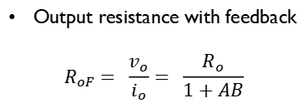
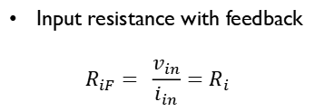
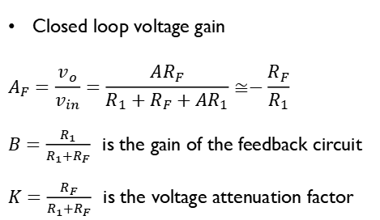
Voltage – Shunt Feedback Amplifier or Inverting Amplifier with feedback
The following figure illustrates the voltage-shunt feedback amplifier and is also referred to as inverting amplifier with feedback.
Closed loop voltage gain
$$A_{F}=\frac{v_{o}}{v_{in}}=\frac{AR_{F}}{R_{1}+R_{F}+AR_{1}}≅−\frac{R_{F}}{R_{1}}$$
$B=\frac{R_{1}}{R_{1}+R_{F}}$is the gain of the feedback circuit
$K=\frac{R_{F}}{R_{1}+R_{F}}$is the voltage attenuation factor
Input resistance with feedback
$$R_{iF}= \frac{v_{in}}{i_{in}}=R_{i}$$
Output resistance with feedback
$$R_{oF}= \frac{v_{o}}{i_{o}}= \frac{R_{o}}{1+AB}$$
Bandwidth with feedback
$$f_{F}= f_{o}(1+AB)$$

Slide 4

Voltage – Shunt Feedback Amplifier or Inverting Amplifier with feedback
Input resistance with feedback
$$R_{iF}= \frac{v_{in}}{i_{in}}=R_{i}$$
Output resistance with feedback
$$R_{oF}= \frac{v_{o}}{i_{o}}= \frac{R_{o}}{1+AB}$$
Total output offset voltage
$$V_{ooT}=\frac{±V_{sat}}{1+AB}$$
Bandwidth with feedback
$$f_{F}= f_{o}(1+AB)$$

Slide 5
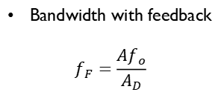


Differential Amplifier
Differential amplifiers are used in instrumentation and industrial applications to amplify the differences between two input signals, like Wheatstone bridge circuits.
These can reject common-mode (noise) voltages better than inverting and non-inverting circuits.
Voltage gain
Output resistance with feedback
$$R_{oF}= \frac{R_{o}}{1+\frac{A}{A_{D}}}$$
$$A_{D}=\frac{v_{o}}{v_{xy}}=−\frac{R_{F}}{R_{1}}$$
Input resistance
$$R_{iFx}≅R_{1}$$
Bandwidth with feedback
$$f_{F}=\frac{Af_{o}}{A_{D}}$$
$$R_{iFy}≅R_{2}+R_{3}$$

Slide 6
Non-Inverting and Inverting Amplifier with feedback-Summary

Slide 7

SELF-ASSESSMENT QUESTIONS
A Differential Amplifier amplifies
Input signal with higher voltage
Input signal with smaller voltage
Sum of the input signals
None of the above
A differential amplifier is capable of amplifying
DC signal only
AC signal only
both
None of the above

Slide 8
SELF-ASSESSMENT QUESTIONS
3. Which factor determines the gain of the voltage shunt feedback amplifier?
Open-loop voltage gain
Feedback voltage
Ratio of two resistors
Gain of feedback cicruit
4. For the inverting feedback amplifier, the output voltage is…..
In phase with the input
180 degrees out of phase with input
zero
infinity

Slide 9
ANSWERS
d
c
c
b

Slide 10
TERMINAL QUESTIONS
How does negative feedback affect the performance of an inverting amplifier?
List two special cases of inverting amplifiers.
Illustrate how negative feedback improves the working of differential amplifier.
The 741C op-amp having the following parameters is connected as inverting amplifier with R₁ = 1 kΩ , and R_{F}=10kΩ, A= 200000, R_{i}= 2MΩ, R_{o}=75Ω, f_{o}=5Hz, supply voltages = ±15V, output swing = ±13 V, UGB = 1 MHz;
Calculate the exact closed-loop gain b) Calculate the ideal closed-loop gain
c) Compare the results of (a) and (b).

Slide 11
REFERENCES FOR FURTHER LEARNING OF THE SESSION
Reference Books:
1. Op-Amps and Linear Integrated Circuit; 4th Ed., Gayakwad, Ramakant A.
Sites and Web links:
https://circuitdigest.com/electronic-circuits/positive-and-negative-feedback-in-op-amp-circuits

Slide 12
THANK YOU
Team – AECD

